Slide 1
Multimodal Food Analysis
Yawen Zhang

Slide 2
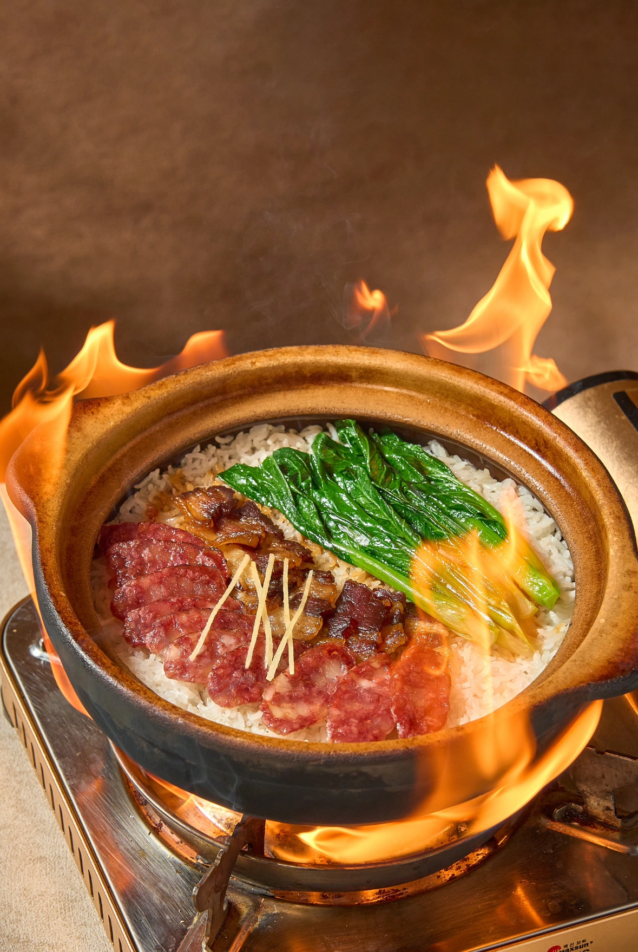
Claypot Rice(煲仔饭）
It is often said that a delicacy is not merely about its taste; rather, it represents the memories of a place and lingers in the recollections of a generation. Whenever I return from traveling and enjoying the mountains and waters, I can always taste different delicacies from all over the world. But in my opinion, none of these new flavors can compare to the old taste in my memory - Claypot Rice.
A simple pot and stove, a bowl of rice paired with the most ordinary vegetables and sausages, along with a little seasoning sauce, and of course, the chef's superb cooking skills, thus created the taste that many people in Guangdong, China, remember.

Slide 3
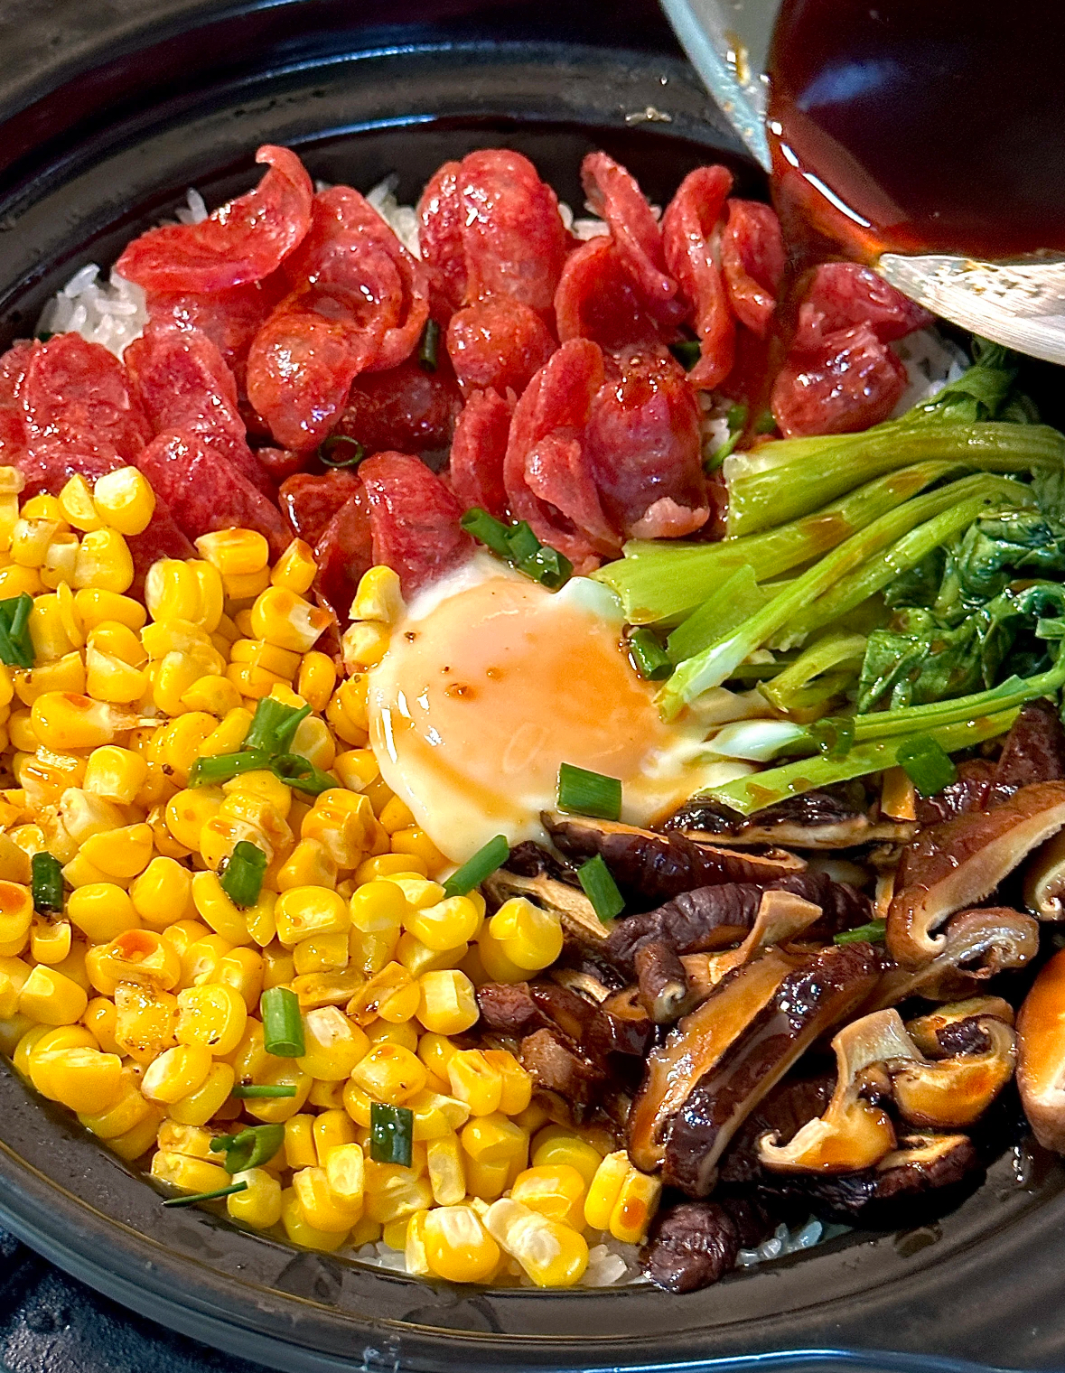
Ingredients:
1. Rice soaked for half an hour
2. One Chicken Egg
3. Some Chinese Sausage
4. Mushroom and Some vegetables you like.
5.All kinds of sauces.（like soy sauce)
Direction:
1. Put the rice that has been soaked for half an hour in a clay pot and add 1.5 times the amount of water.
2.After the water boils, cover the pot and turn the heat down to low for 10 minutes. Then add the sausages and blanched vegetables.
3.After the sausage is simmered until cooked, add a raw egg and continue to cover the pot to simmer for 3 to 4 minutes.
4.Just add a little light soy sauce and dark soy sauce and it's ready to eat.

Slide 4
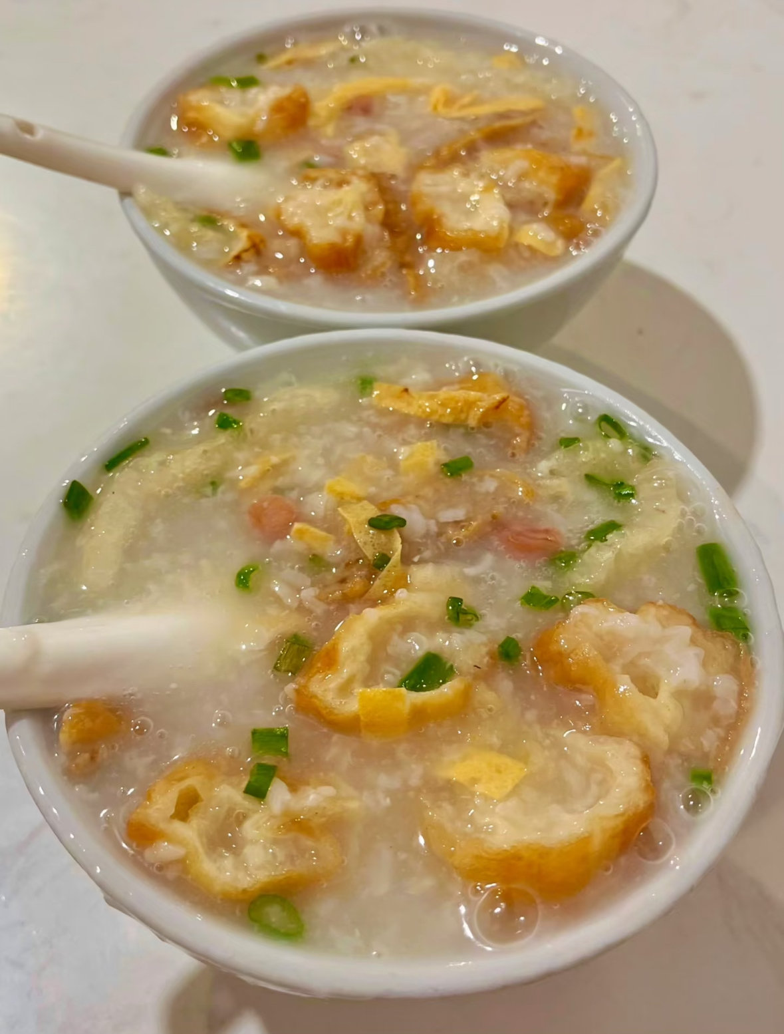
Ting Zai Congee(艇仔粥）
In Cantonese, "tingzai" refers to small fishing boats that cannot withstand the waves of the sea and almost only work near the shore. Before the fishing season begins, the people living on the boat will cook a pot of white porridge at the tail of the cabin. During the fishing season, the porridge is simmered over a low flame on the stove. As soon as the fish and shrimp are caught, they should be processed immediately while they are still fresh, and then directly poured into the pot to cook together. When the fish and shrimp are cooked, they can be eaten. This is the earliest origin of the Ting Zai Congee porridge.

Slide 5
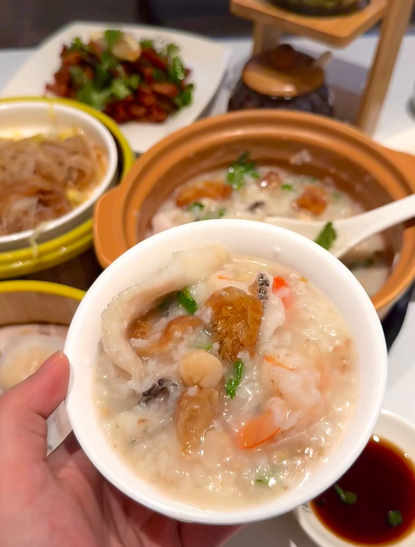
Ingredients:
1. Rice soaked for an hour and glutinous rice
2. Fresh fish slices and shredded squid
3. Cut the fried dough sticks into small sections
4. Fried peanuts
5.Chopped green onion
Direction:
1. Blanch the squid tentacles to remove the fishy smell. Marinate the fresh fish slices with salt, pepper and starch for ten minutes.
2.Wash the rice and freeze it for 30 minutes. Then put it in a pot, add water and bring to a boil. After that, turn to low heat and simmer for an hour until the rice grains melt.
3.Put the sashimi and shredded squid at the bottom of the bowl.
4.Pour the boiling pot bottom directly into the bowl to cook the ingredients at the bottom of the bowl. Finally, sprinkle in fried peanuts, fried dough sticks and chopped scallions.

